Slide 1
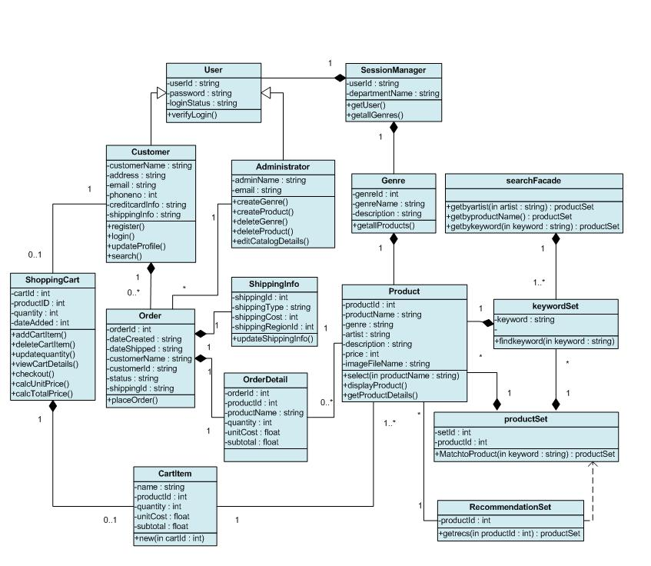


CMSC 2133 Object Oriented Programming Intro
Prof. David North

Slide 2
What is OOP
It is programing by organizing the data and code into objects.
It is programming using OO CS Principles.

Slide 3
What are the approaches (paradigms) to Programming
Procedural
Fortran
Cobol
Basic
C
Object Oriented
Smalltalk
C++
C #
Java
Functional
Lisp
Haskel
F#

Slide 4
What is an Object?
An Object is an abstraction of a person, place or thing.
An Object can know things.
An Object can do things.
Objects do work by sending messages to other objects asking them to do things.
I often think of Objects as being alive.

Slide 5
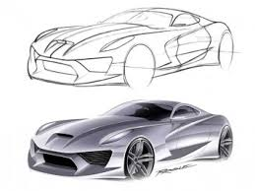
What is an Object?
A specific instance of a Car
It is a thing.
What does a car know?
What does it do?

Slide 6
What is an Class?
It is the definition of a set of similar objects.
A Class is a template for defining and creating objects.
It has a Name.
It has a list of attributes that apply to all objects in a Class.
It has a list of services (methods) that apply to all objects in a Class.

Slide 7
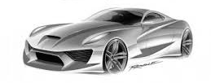
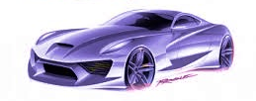
What is an Class?
What is the class for all the cars?
Name: Car (usually singular)
Attributes:
Make
model
year
color
mileage
gear
Services(methods):
start
stop
change gears
go

Slide 8
OOP Languages
Provide support for Classes
Instance variables (attributes)
Methods (services)
Allow the creation of Objects – instances of classes
Provide a mechanism for sending messages to objects.
Support OOP principles
Abstraction
Encapsulation
Inheritance
Polymorphism

Slide 9
In OOP Languages we define classes
public class Car {
// instance variables
private String serialNumber;
private String make;
private String model;
private int year;
private String color;
private int mileage;
private int speed;
private char gear;
// default constructor
public Car ()
{
this.mileage=0;
this.gear ='P';
this.speed = 0;
}
}
We define classes when we write code in OO languages
We create objects when the program is run based on those classes.

Slide 10
Computer Science Principles
A Computer Science Principle is a concept that has been shown over time that it can be applied in many areas of Computer Science as a part of a good solution.
As ideas to make good solutions
As a way to decide how to do something
As a way to evaluate a solutions

Slide 11
Computer Science Principles
Abstraction
Binding
Encapsulation
Data Representation
Algorithms
Reuse
Patterns
Efficiency
Tradeoffs and Consequences
Consistency and Completeness
Polymorphism
Inheritance
Separation of Concerns

Slide 12
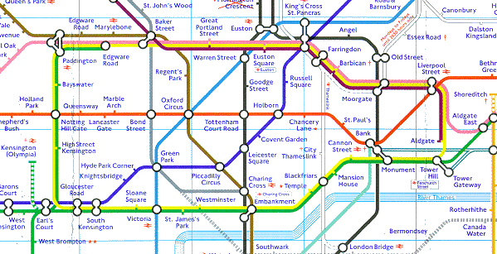
Abstraction
An Abstraction is a representation of a real thing with something that is not the real thing. Often details are left out to make it easier to user.
Real World Examples :
abstract art
Map
model
CS Examples :
representing letters as numbers
representing real word things as objects

Slide 13

Binding
Binding is the action of associating something with a specific item. Often it is a name for something.
Real World Examples :
Associating an address to a
house
Giving a child a name
CS Examples :
associating a variable name to a memory location
associating a type with a variable

Slide 14
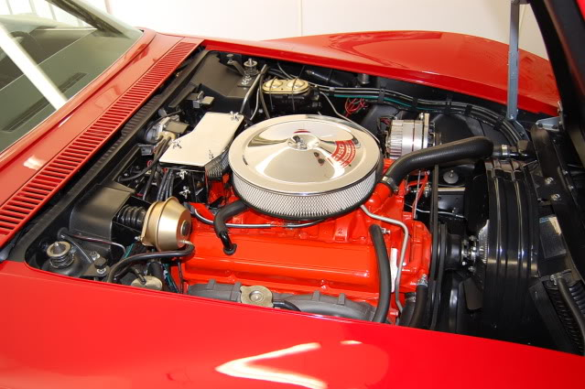
Encapsulation
Encapsulation is hiding how something works from those that use it.
Real World Examples :
A car engine
A computer
CS Examples :
Creating a function that performs a specific service.
Creating an object that knows things
Hiding how an object knows and does things

Slide 15
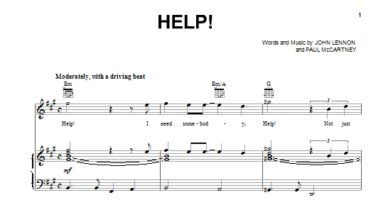
Data Representation
Data Representation is representing the information about real world data in some systematized way.
Real World Examples :
Sheet music
Braille
CS Examples :
ASCII code
Objects

Slide 16
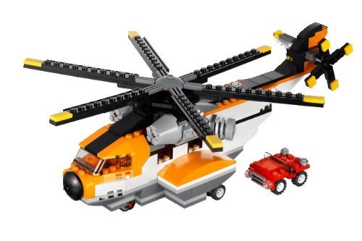
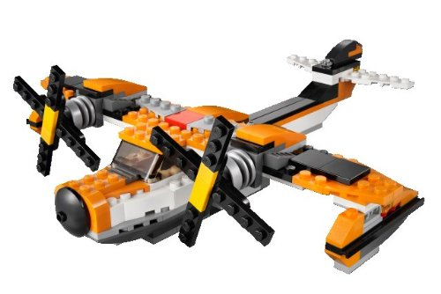
Reuse
Reuse is using a particular technique, concept or systems more than once, often in a new context or situation.
Real World Examples :
Legos
CS Examples :
reuse of software libraries
reuse of services in objects
in an application

Slide 17
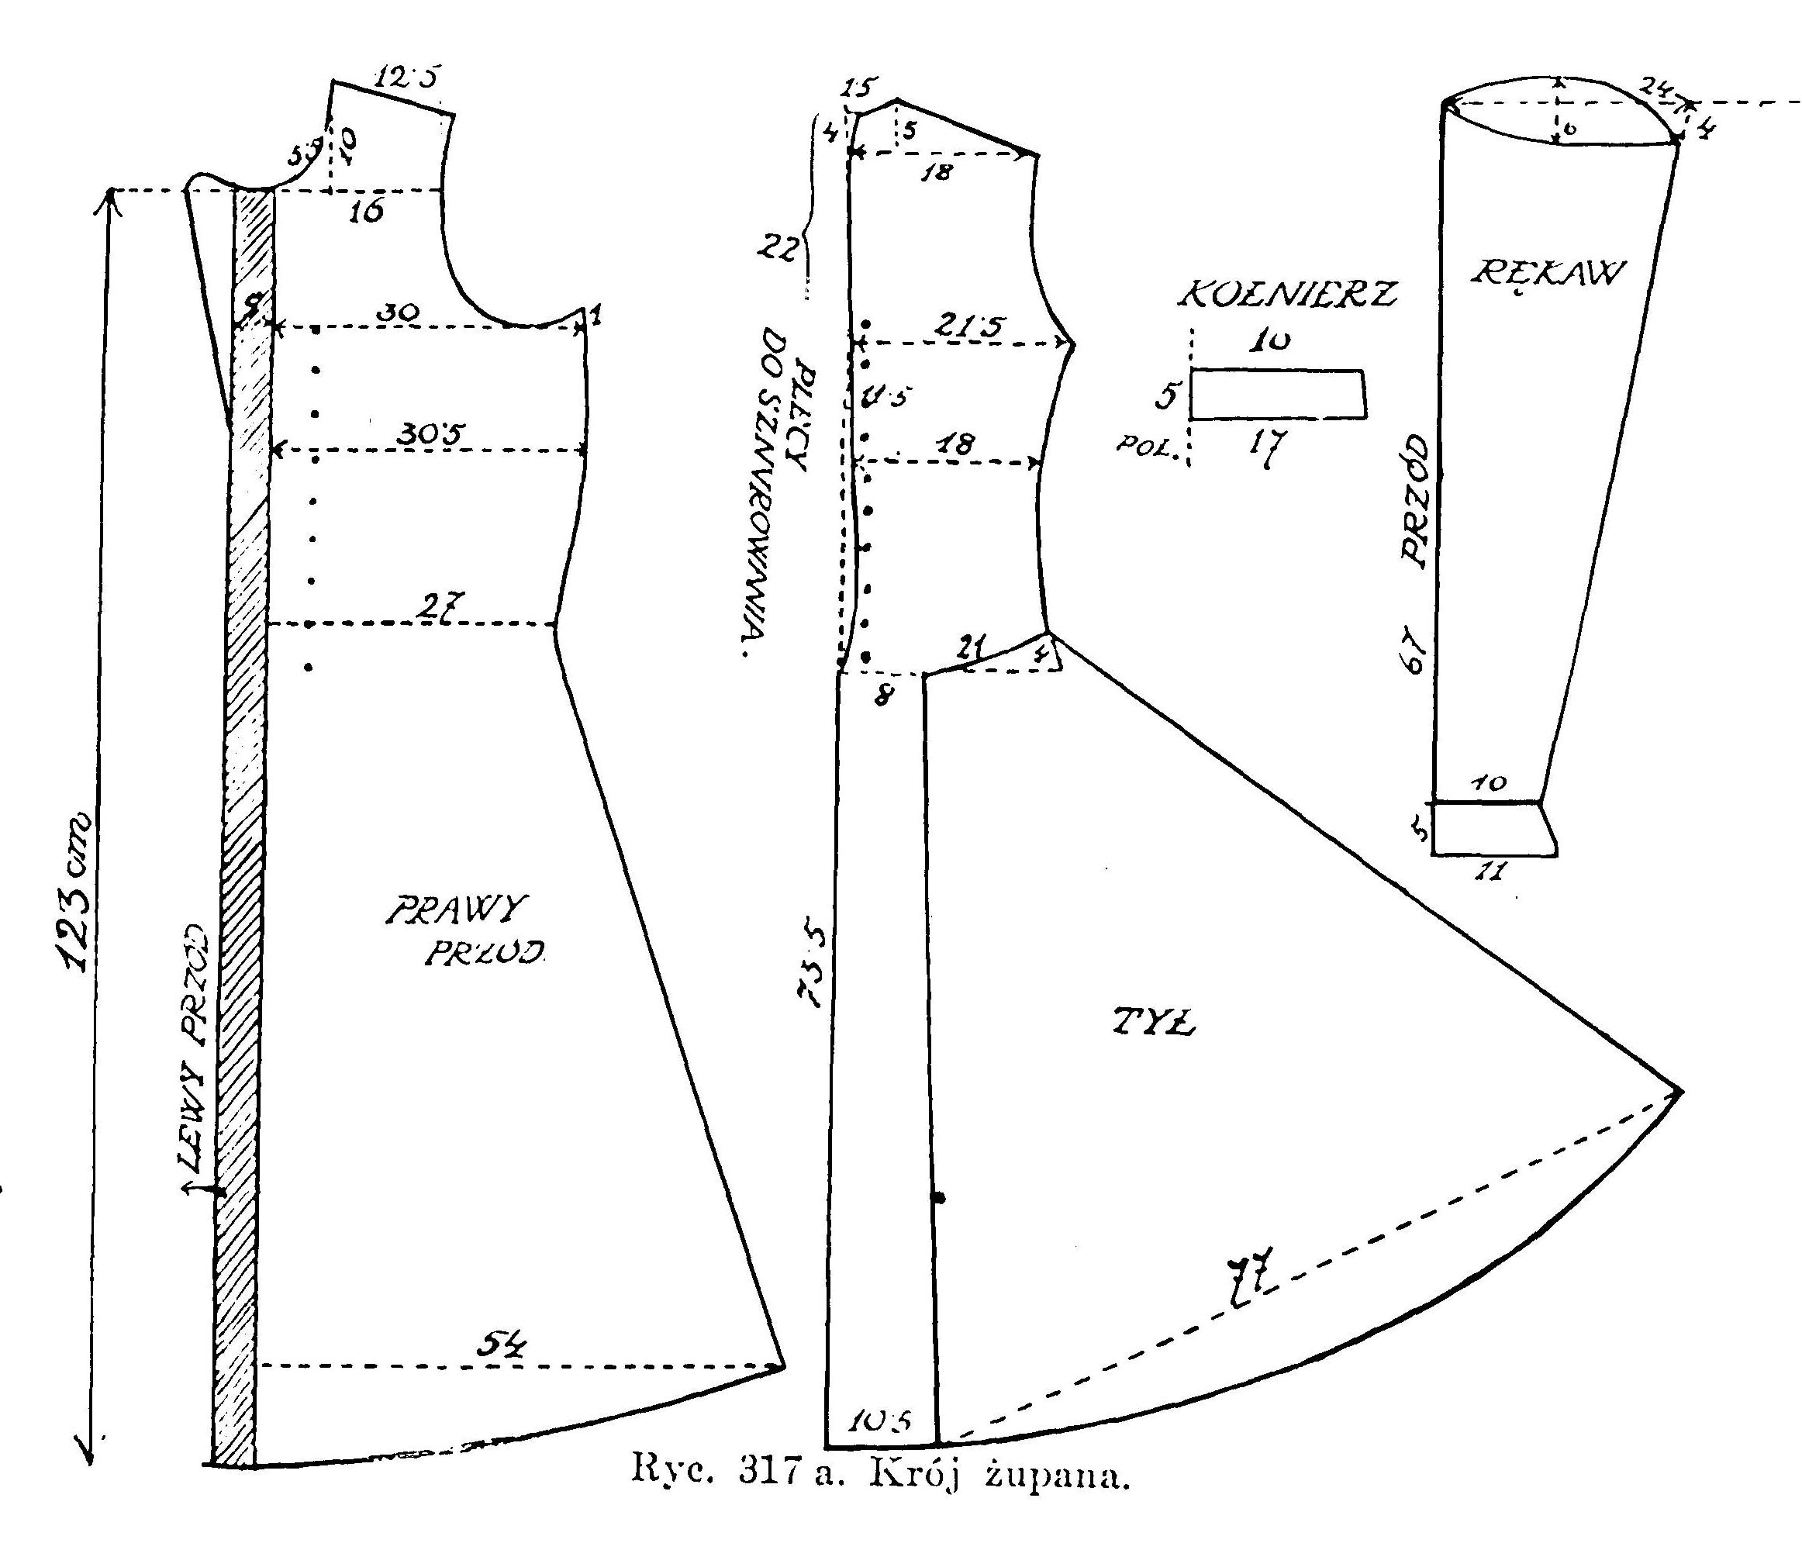
Patterns
A Pattern is a template that can be used to solve problems. It can be used many times.
Real World Examples :
Dress Pattern
CS Examples :
System architecture patterns
Patterns of arrangements of objects in an application

Slide 18

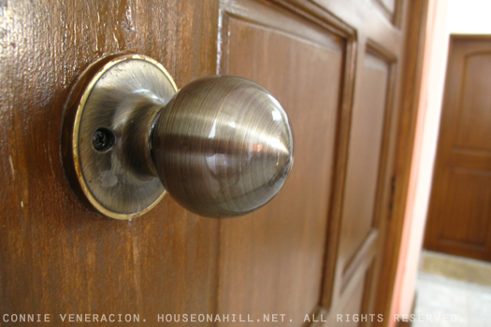

Polymorphism
Polymorphism is using the same name to refer to similar functions in different classes of objects.
Real World Examples :
Opening a door
CS Examples :
Methods with the same name
but in different Classes

Slide 19
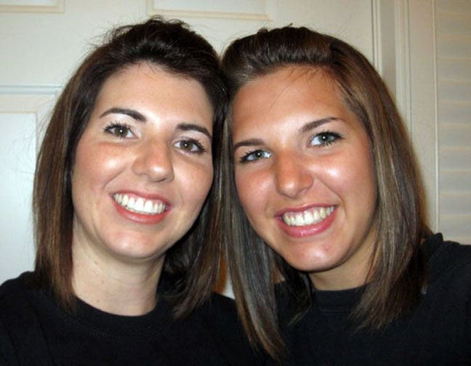
Inheritance
Inheritance is when the parents pass on characteristics to the children. It is a form of reuse.
Real World Examples :
Children look like Parents
CS Examples :
Parent Class pass on
attributes and methods to child class.

Slide 20
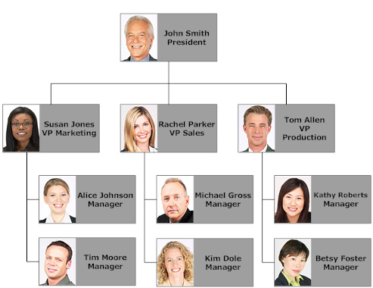
Separation of Concerns
Separation of Concerns is assigning responsibilities to the entity where they belong and not mixing the responsibilities between entities.
Real World Examples :
Organizational responsibilities
CS Examples :
Separation in to packages
A method that does only one thing

Slide 21
Class Overview
Learn OOP CS Principles
Abstraction
Binding
Encapsulation
Reuse
Patterns
Inheritance
Polymorphism
Separation of Concerns

Slide 22
Class Overview
Learn OOP CS Knowledge
OO Concepts
Java
Data Structures
UI (User Interface)
Database
UML
Iterative Development
Problem Specification

Slide 23
Class Overview
Learn OOP CS Skills
Problem Solving
Object /UML Modeling
OOP – Object Oriented Thinking
Java Programming
Eclipse

Slide 24
Class Overview
Just in time learning:
Project 1 – Dice Roller
Project 2 – Point of Sale
Project 3 - Persistence

Slide 25
Lab
Primarily for getting assistance on your assignments.
If the current assignment is not completed you are required to come to lab.

Slide 26
Assignment 1
Read chapter 1-4
You are expected to learn this material on your own.
Review end of chapter materials
View Java Videos

Slide 27
Assignment 2
Install Java
Install Eclipse
Write Hello World
Write Prog 1 and Prog 2
View Eclipse Video

Slide 28
Installing Java
Java is currently maintained by Oracle.
(They purchased Sun)
Need the Java SDK to get the Java libraries and the JVM
http://www.oracle.com/technetwork/java/javase/downloads/index.html

Slide 29
Eclipse
Eclipse is a Integrated Development Environment (IDE).
Eclipse is an Open Source Project maintained by the Eclipse Foundation.
Eclipse IDE for Java Developers.
Use Mars 4.5 version.
https://eclipse.org/

Slide 30
Next
Do Assignment 1 on your own
Lab Today 3:40
Do Assignment 2 in Lab

